Slide 1


LENDING CLUB MIS 636-901
Group 5
Apurva Tawde and Trinh Nguyen

Slide 2

Lending Club
Lending Club is a US peer-to-peer lending company.
The company claims that $15.98 billion in loans had been originated through its platform up to December 31, 2015.
Lending Club enables borrowers to create unsecured personal loans between $1,000 and $40,000.
The standard loan period is three years.
Investors can search and browse the loan listings on Lending Club website and select loans that they want to invest in
Investors make money from interest.
Lending Club makes money by charging borrowers an origination fee and investors a service fee.
Notes:
LendingClub is a US peer-to-peer lending company. The company claims that $15.98 billion in loans had been originated through its platform up to December 31, 2015. Lending Club enables borrowers to create unsecured personal loans between $1,000 and $40,000.
The standard loan period is three years. Investors can search and browse the loan listings on Lending Club website and select loans that they want to invest in based on the information supplied about the borrower, amount of loan, loan grade, and loan purpose. Investors make money from interest.
Lending Club makes money by charging borrowers an origination fee and investors a service fee.

Slide 3



BUSINESS PROBLEMS
Loan Issuance by State
Over 19 states in the US issued total loan amounts of over $50 million and more, whereas 14 states held a total of $25-50 million and the remaining 18 states issued total loan amount between $0-25 million.
Adjusted NAR
If I invest in multiple loans then my adjusted NAR would be high in the beginning and over the period of time as we traverse, the adjusted NAR decreases due to multiple reasons, one of which is the loan can end up being charged off.
NAR Level
Over an increase in time, the adjusted NAR falls.
Increase in Interest Rate
Loan grades A to D have a constant interest rate band whereas there is a significant increase in the interest rates with loan grades E to G with a substantial increase of 10%
Grade Mix
Grade mix over time shows that lower the grade of the loan, lower issuance for that loan have been made over the years. Loan grades B, C followed by A were the maximum issued loan grades.
Amount of Loan
Loan status migration over 9 months shows us that the loans which are past due, 22% of those loans end up being in the net-charged off status in the grace period whereas 78% of the loans in the grace period remain active.

Slide 4

BUSINESS GOALS
Understand the Credit Risk
Borrowing Patterns
Investment Opportunities
Understand Consumer Choice and Behavior.
Notes:
With the release of Lending club data
We want to leverage this dataset to understand credit risk, borrowing patterns, investment opportunities and to understand consumer choice and behaviors.
This dataset is a gold mine to teach data science

Slide 5
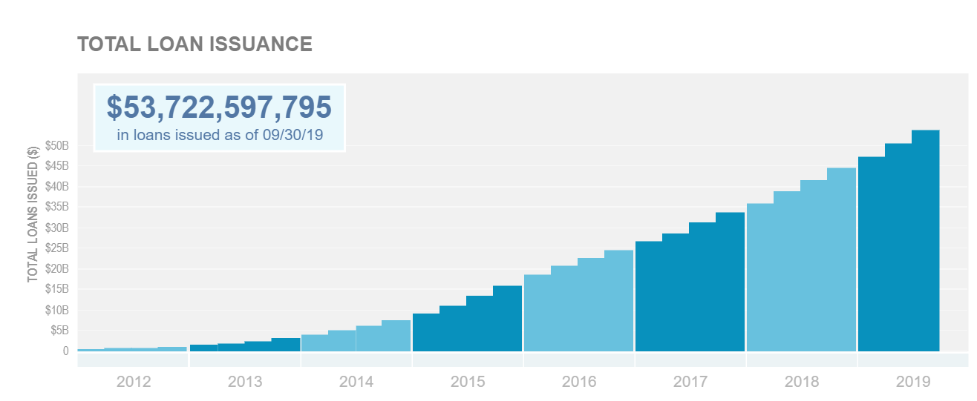
KEY TAKEAWAY FROM CLIENTS
From the total loan issuance graph, it can be seen that the amount of loans disbursed year over year increased as we go from 2011 to 2018, and within the years, the growth is exponential in every quarter.
Notes:
When we look at the data from the company website, as of September of 2019, there are more than 53 billions in loan issued.

Slide 6

DATA EXPLORATION
- We have 74 columns of data out of which 20 are Categorical Variables and 54 are Numeric Variables.
- 38 of 74 columns allow NULL values.
- Most Categorical Variables are Text (Descriptions) whereas the others are Date (Days of Week, Months).
- Some Numeric Variables are derived based on the values of Other Numeric Variables.
- Borrower Features: member_id, emp_title, emp_length, home_ownership, annual_inc, zip_code, addr_state, dti, delinq_2yrs, earliest_cr_line, inq_last_6mths, mths_since_last_delinq, mths_since_last_record, open_acc, pub_rec, revol_bal, revol_util, total_acc, acc_now_delinq, tot_cur_bal, open_acc_6m, open_il_6m, open_il_12m, open_il_24m, mths_since_rcnt_il, total_bal_il, il_util, open_rv_12m, open_rv_24m, max_bal_bc, all_util, total_rev_hi_lim, inq_fi, total_cu_tl, inq_last_12m
- Loan related Features: id, loan_amnt, funded_amnt, funded_amnt_inv, term, int_rate, installment, grade, sub_grade, verification_status, issue_d, loan_status, pymnt_plan, url, desc, purpose, title, initial_list_status, out_prncp, out_prncp_inv, total_pymnt, total_pymnt_inv, total_rec_prncp, total_rec_int ,total_rec_late_fee ,recoveries ,collection_recovery_fee ,last_pymnt_d ,last_pymnt_amnt ,next_pymnt_d ,last_credit_pull_d ,collections_12_mths_ex_med ,mths_since_last_major_derog, ,policy_code, application_type, annual_inc_joint, dti_joint, verification_status_joint, tot_coll_amt

Slide 7
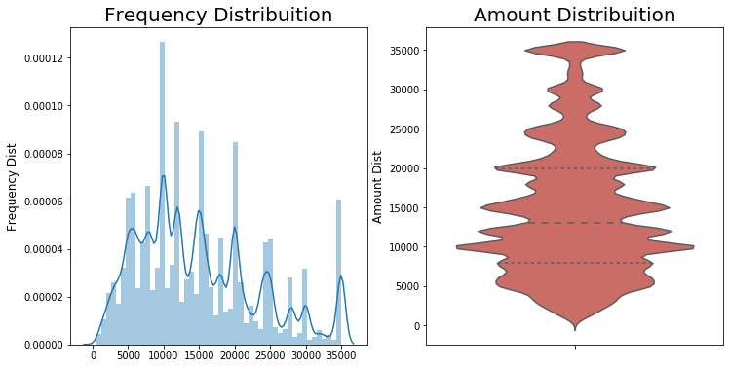
DISTRIBUTION OF LOAN AMOUNT
As per the Frequency Distribution of the Load amount large count increase from $10,000 to $20,000
For Amount Distribution the median value lies between $10,000 to $15,000 and has more distribution for amount $10,000

Slide 8
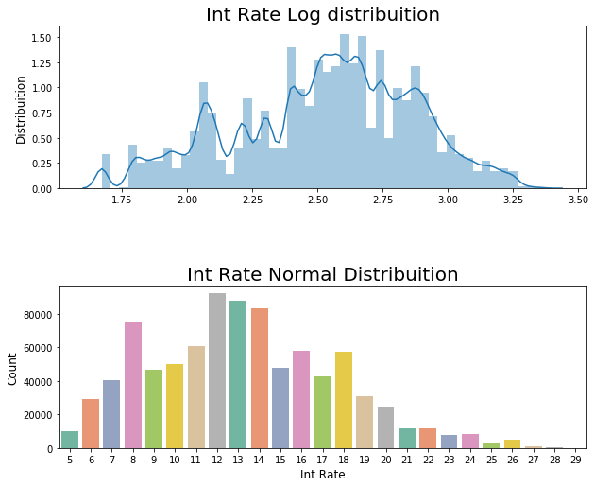
DISTRIBUTION OF INTEREST RATE
The Log Distribution Of the Int Rate is high between 2.50 to 2.75
For Normal distribution Int Rate has a widespread, with mean value 13.25 & SD of 4.38

Slide 9
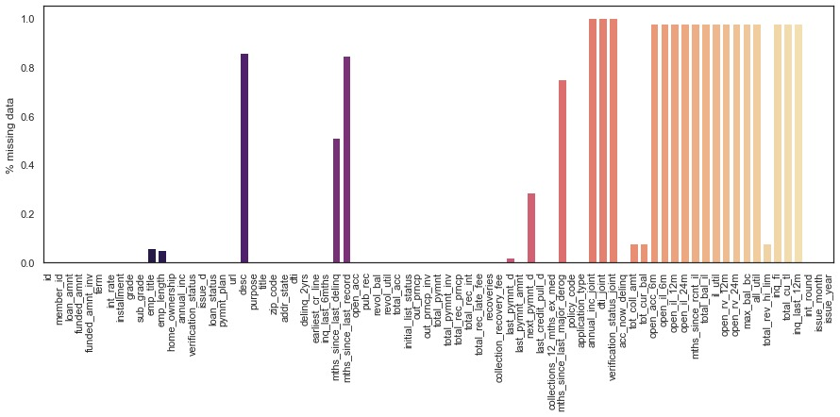
MISSING DATA
17,998,490 values are missing in the dataset
The total percentage of missing values in data set is 27.41%

Slide 10

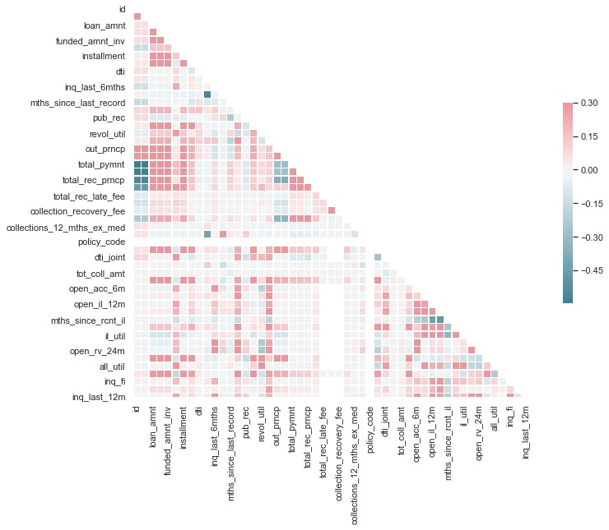
CORRELATION PLOT
Loan_amt is highly correlated with funded_amnt, funded_amnt_inv, installment, out_prncp, out_prncp_inv, total_rec_int
int_rate is highly correlated to int_round

Slide 11
DATA CLEANING
Data Cleansing
We drop 20 columns with more than 50% of missing values
We convert 8 categorical variables to dummy variables
MICE
MICE is "multiple imputation by chained equations". Basically, missing data is predicted by observed data, using a sequential algorithm that is allowed to proceed to convergence.
Normalization
Science we have multiple variables with different scales it was necessary that we normalize the data

Slide 12

FEATURE ENGINEERING
Feature engineering is the process of using domain knowledge of the data to create features that make machine learning algorithms work.
If feature engineering is done correctly, it increases the predictive power of machine learning algorithms by creating features from raw data that help facilitate the machine learning process.
Notes:
Feature engineering is the process of using domain knowledge of the data to create features that make machine learning algorithms work.
If feature engineering is done correctly, it increases the predictive power of machine learning algorithms by creating features from raw data that help facilitate the machine learning process.
Feature tool helps a user to find some features that are necessary for mathematical calculation like avg,min,max,count etc.
Feature tool have a lots of limitation like you need to pass proper entities before gaining features out of it.
If a user needs to find some function related to maths then feature tool is useful. Feature tool works well only with the numeric data.
A user needs to decide manually first what features he need and the pass the primitives accordingly.In short it is manually feature selection .

Slide 13
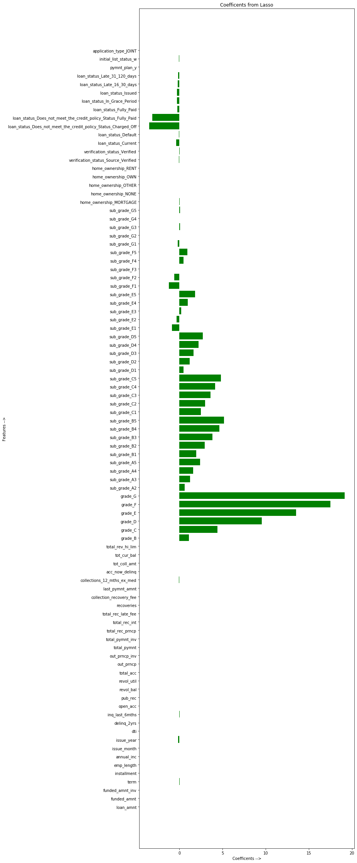
FEATURE SELECTION USING LASSO
Lasso picked 82 variables and eliminated the other 9 variables
Out of which only 15 variables were further selected to build model
('grade_C','grade_D','grade_E', 'grade_F','grade_G','total_rec_int', 'total_pymnt_inv','funded_amnt_inv','sub_grade_B5','sub_grade_C5','sub_grade_C4','sub_grade_B4','sub_grade_D5','sub_grade_C3’)

Slide 14
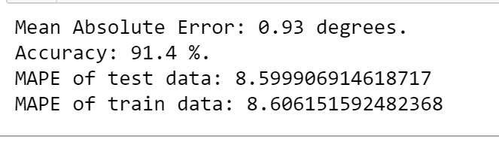
LINEAR REGRESSION
Parameters used by us :
Y = int_rate
X = grade_C,grade_D,grade_E, grade_F,grade_G,total_rec_int,total_pymnt_inv,funded_amnt_inv,sub_grade_B5, sub_grade_B4,sub_grade_C5,sub_grade_C4,sub_grade_C3,sub_grade_D5
Alpha = 1
Train & Test Data Split : 60% & 40%
Linear regression is used to predict a quantitative response Y from the predictor variable X.
It is made with an assumption that there's a linear relationship between X and Y.

Slide 15
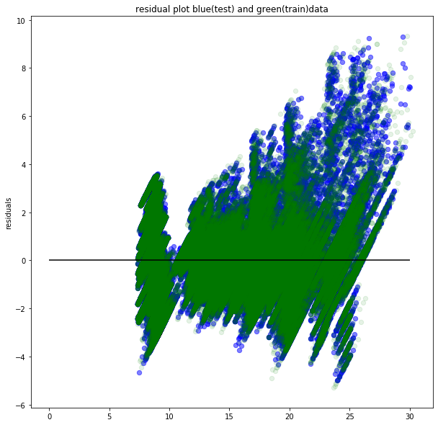
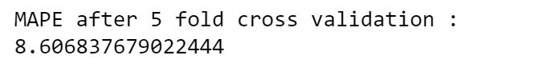
RESIDUALS & MAPE After 5-fold Cross Validation
MAPE IS mean absolute percentage deviation (MAPD), is a measure of prediction accuracy of a forecasting method
When we plot the residual plot you can see the data is randomly scattered around 0 horizontal line which means the model is a good fit
We then apply 5-fold cross validation, the MAPE value changes by 0.01

Slide 16
RANDOM FOREST
Parameters used by us :
Y = int_rate
X = grade_C,grade_D,grade_E, grade_F,grade_G,total_rec_int,total_pymnt_inv,funded_amnt_inv,sub_grade_B5, sub_grade_B4,sub_grade_C5,sub_grade_C4,sub_grade_C3,sub_grade_D5
n_estimators = 10
random_state = 42
Train & Test Data Split : 75% & 25%
A Random Forest is an ensemble technique capable of performing both regression and classification tasks with the use of multiple decision trees
Significance of parameters used :
n_estimators : (number of trees)
random_state : seed : Specify the random number generator (RNG) seed for algorithm components dependent on randomization. The seed is consistent for each H2O instance so that you can create models with the same starting conditions in alternative configurations.

Slide 17
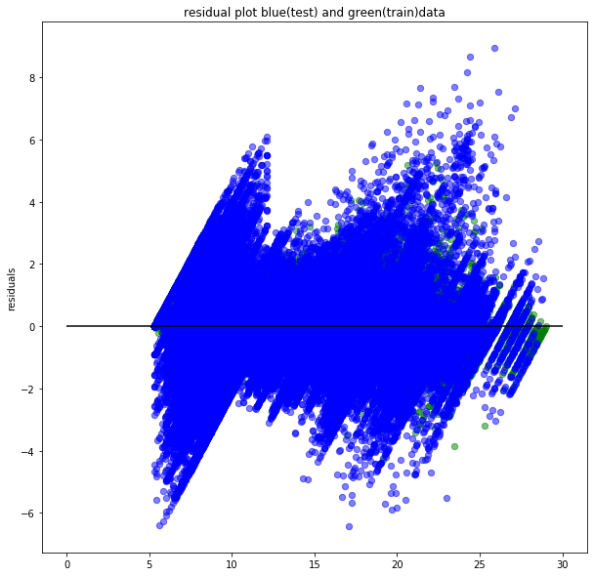
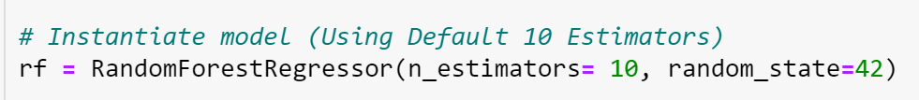
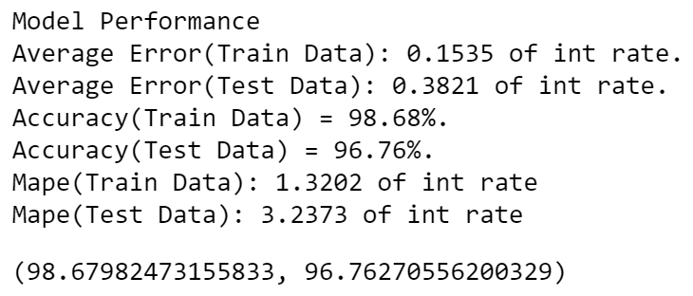
Random Forest With Necessary Parameter

Slide 18
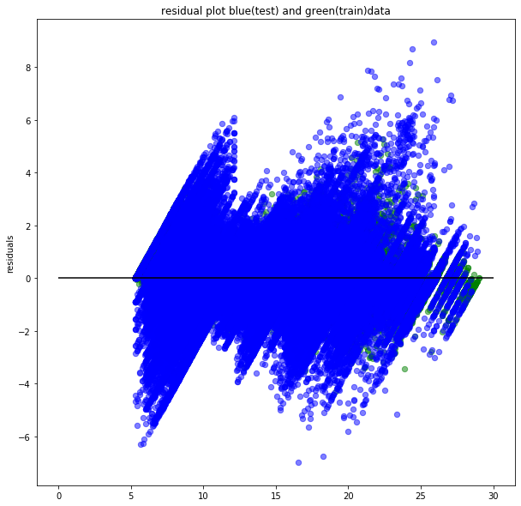
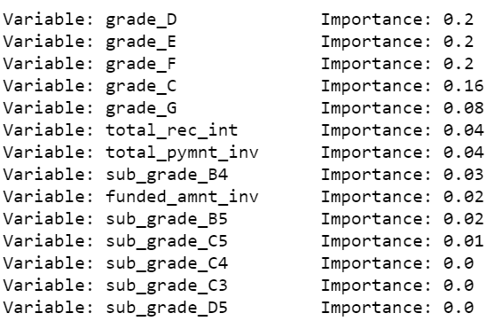
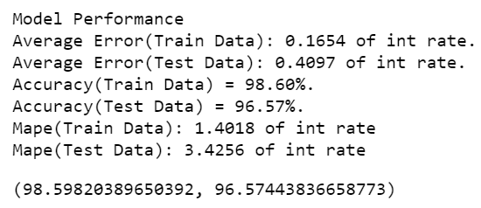
Random Forest With Most Important Features

Slide 19
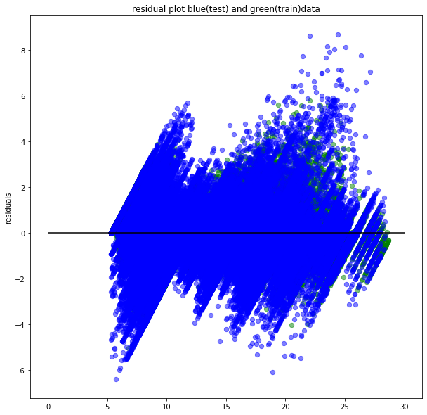
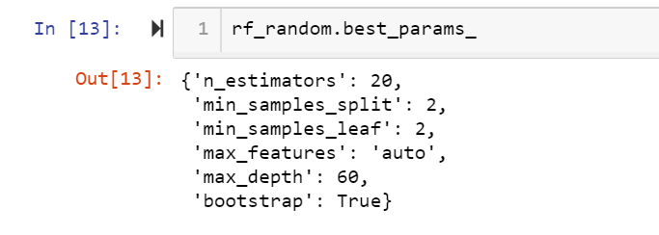
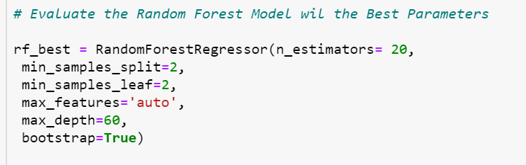
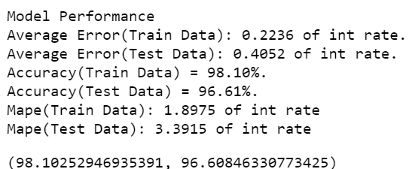
Random Search [Grid] With Cross Validation

Slide 20
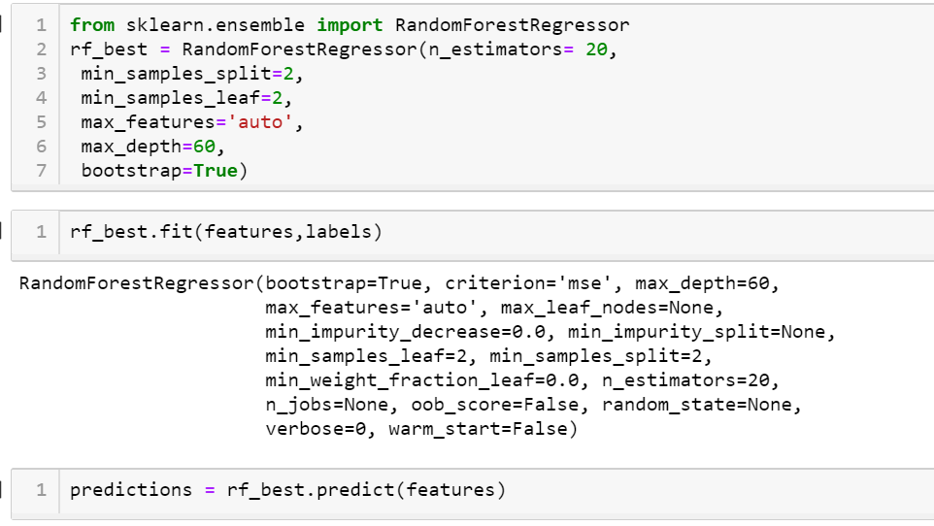
Prediction
We use the model that was last obtained from Random forest with Cross validation over the test Dataset and make prediction

Slide 21
CONCLUSION
Models | Linear Regression | Random Forest
MAPE | 8.60 | 3.39
Amongst all of the models we can see that Random Forest regressor gives us the best predictions.
Given, any test case including the ones carried out by our team, the predicted values can be seen satisfactory as compared to the actual data of interest rates provided by the lending club.

Slide 22

THANK YOU!

